Slide 1


Data Cleaning and transformation
2
+
College of Computer Science And Information Technology
2
+
Session 1

Slide 2
Data cleaning – basic methods
Combining and Merging data sets
Reshaping and Pivoting
Data Transformation
Data duplicated
Missing data
Outlier
Sampling

Slide 3
Combining and Merging data sets
pandas.merge: connect rows in DataFrame based on one or more keys.
Join operation in SQL
pandas.concat: stacks together objects along an axis
Combine_first : instance method enables splicing together overlapping data to fit in missing values in one object with values form another.

Slide 4
Pandas - Merge
one-to-one joins: for example when joining two DataFrame objects on their indexes (which must contain unique values).
many-to-one joins: for example when joining an index (unique) to one or more columns in a different DataFrame.
many-to-many joins: joining columns on columns.

Slide 5
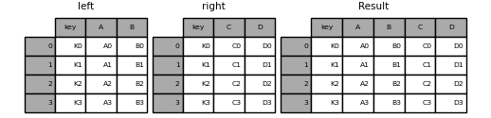
Pandas - Merge
left = pd.DataFrame(
{
"key": ["K0", "K1", "K2", "K3"],
"A": ["A0", "A1", "A2", "A3"],
"B": ["B0", "B1", "B2", "B3"],
}
)
right = pd.DataFrame(
{
"key": ["K0", "K1", "K2", "K3"],
"C": ["C0", "C1", "C2", "C3"],
"D": ["D0", "D1", "D2", "D3"],
}
)
result = pd.merge(left, right, on="key")

Slide 6
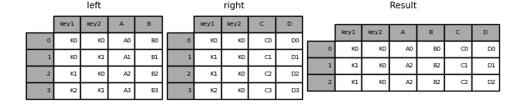
Pandas – Merge: inner join
left = pd.DataFrame(
{
"key1": ["K0", "K0", "K1", "K2"],
"key2": ["K0", "K1", "K0", "K1"],
"A": ["A0", "A1", "A2", "A3"],
"B": ["B0", "B1", "B2", "B3"],
}
)
right = pd.DataFrame(
{
"key1": ["K0", "K1", "K1", "K2"],
"key2": ["K0", "K0", "K0", "K0"],
"C": ["C0", "C1", "C2", "C3"],
"D": ["D0", "D1", "D2", "D3"],
}
)
result = pd.merge(left, right, on=["key1", "key2"])
Only the keys appearing in left and right are present (the intersection), since how='inner' by default.

Slide 7
Merge method | SQL Join Name | Description
left | LEFT OUTER JOIN | Use keys from left frame only
right | RIGHT OUTER JOIN | Use keys from right frame only
outer | FULL OUTER JOIN | Use union of keys from both frames
inner | INNER JOIN | Use intersection of keys from both frames
cross | CROSS JOIN | Create the cartesian product of rows of both frames

Slide 8
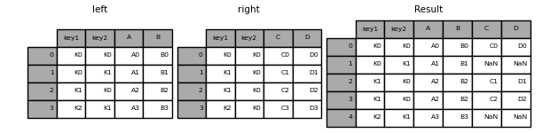
Merge-method: left
result = pd.merge(left, right, how="left", on=["key1", "key2"])

Slide 9
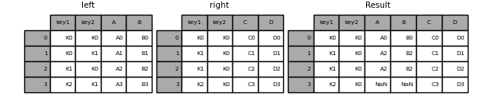
Merge-method: right
result = pd.merge(left, right, how="right", on=["key1", "key2"])

Slide 10
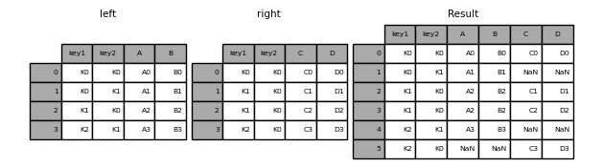
Merge-method: outer
In [41]: result = pd.merge(left, right, how="outer", on=["key1", "key2"])

Slide 11
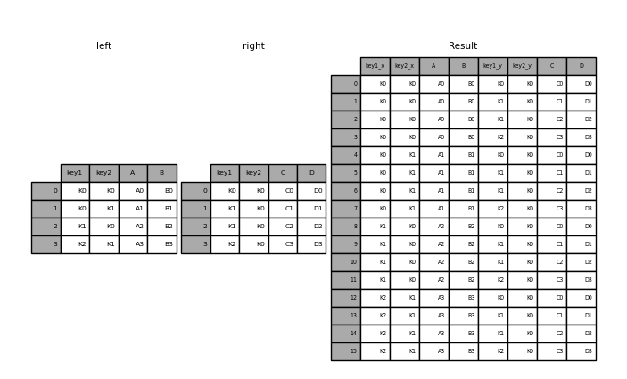
Merge-method: cross
result = pd.merge(left, right, how="cross")

Slide 12
Merge based on the nearest time-stamp
ASOF package in python
This method is used to perform an asof merge. This is similar to a left-join except that we match on nearest key rather than equal keys. Both DataFrames must be sorted by the key
Syntax : pandas.merge_asof(left, right, on=None, left_on=None, right_on=None, left_index=False, right_index=False, by=None, left_by=None, right_by=None, suffixes=(‘_x’, ‘_y’), tolerance=None, allow_exact_matches=True, direction=’backward’, )

Slide 13
Concatenating Along an Axis
Another kind of data combination operation is alternatively referred to as concatenation, binding, or stacking. NumPy has a concatenate function for doing this with raw NumPy arrays
arr = np.arange(12).reshape((3, 4))
Print values from 0 to 11 in a 3 rows and 4 columns array
np.concatenate([arr, arr], axis=1)
Duplicate the array

Slide 14
Reshaping and Pivoting
Session 2

Slide 15
Reshaping
There are a number of fundamental operations for rearranging tabular data. These are alternatingly referred to as reshape or pivot operations.
Reshaping with Hierarchical Indexing
Hierarchical indexing provides a consistent way to rearrange data in a DataFrame. There are two primary actions:
stack: this “rotates” or pivots from the columns in the data to the rows
unstack: this pivots from the rows into the columns

Slide 16
stack
data = pd.DataFrame(np.arange(6).reshape((2, 3)), index=pd.Index(['Ohio', 'Colorado'], name='state'),columns=pd.Index(['one', 'two', 'three'], name='number'))
data.stack()
number | one | two | three
state
Ohio | 0 | 1 | 2
Colorado | 3 | 4 | 5
State | number
Ohaio | One | 0
 | Two | 1
 | Three | 2
Colorado | One | 3
 | Two | 4
 | three | 5
Using the stack method on this data pivots the columns into the rows
What unstack function do?

Slide 17
Pivoting
Reshaping a data from long to wide in python pandas is done with pivot() function.
Pivot() function in pandas is one of the efficient function to transform the data from long to wide format.
 | countries | metrics | values
0 | A | population_in_million | 100
1 | B | population_in_million | 200
2 | C | population_in_million | 120
3 | A | gdp_percapita | 2000
4 | B | gdp_percapita | 7000
5 | C | gdp_percapita | 15000
Long format
Notes:
d = {
'countries':['A','B','C','A','B','C'],
'metrics':['population_in_million','population_in_million','population_in_million',
'gdp_percapita','gdp_percapita','gdp_percapita'],
'values':[100,200,120,2000,7000,15000]
}
df = pd.DataFrame(d,columns=['countries','metrics','values'])
df

Slide 18
Pivoting
df2=df.pivot(index='countries', columns='metrics', values='values')
metrics | gdp_percapita | population_in_million
countries
A | 2000 | 100
B | 7000 | 200
C | 15000 | 120
Wide format

Slide 19
Data Transformation
Session 3

Slide 20
Data Transformation
Removing Duplicates
Transforming Data Using a Function or Mapping
Replacing Values
Renaming Axis Indexes
Detecting and Filtering Outliers

Slide 21
Removing Duplicates
Duplicate rows may be found in a DataFrame for any number of reasons.
data.duplicated()
returns a boolean Series indicating whether each row is a duplicate or no
data.drop_duplicates()
drop_duplicates returns a DataFrame where the duplicated array is True
 | k1 | K2
0 | one | 1
1 | one | 1
2 | one | 2
3 | two | 3
4 | two | 3
5 | two | 4
6 | two | 4
0 | F
1 | T
2 | F
3 | F
4 | T
5 | F
6 | T
 | k1 | K2
0 | one | 1
2 | one | 2
3 | two | 3
5 | two | 4
data.duplicated()
data.drop_duplicates()

Slide 22
Transforming Data Using a Function or Mapping
For many data sets, you may wish to perform some transformation based on the values in an array, Series, or column in a DataFrame.
 | food | ounces
0 | egg | 4.0
1 | pulled beef | 3.0
2 | egg | 12.0
3 | Pastrami | 6.0
4 | corned beef | 7.5
5 | egg | 8.0
6 | pastrami | 3.0
7 | honey beef | 5.0
8 | nova lox | 6.0
Add a column indicating the type of animal that each food came from
Write down a mapping of each distinct meat type to the kind of animal
meat_to_animal = {
egg': chicken',
'pulled beef': cow',
'pastrami': 'cow',
'corned beef': 'cow',
'honey beef': cow',
'nova lox': 'salmon‘ }

Slide 23
Transforming Data Using a Function or Mapping
2. data['animal'] = data['food'].map(str.lower).map(meat_to_animal)
Add a column to dataset (data) and use map function to add the created list
 | food | ounces | animal
0 | egg | 4.0 | chicken
1 | pulled beef | 3.0 | cow
2 | egg | 12.0 | chicken
3 | Pastrami | 6.0 | cow
4 | corned beef | 7.5 | cow
5 | egg | 8.0 | chicken
6 | pastrami | 3.0 | cow
7 | honey beef | 5.0 | cow
8 | nova lox | 6.0 | salmon

Slide 24
Replacing Values
Suppose you have the following dataset
data = pd.Series([1., -999., 2., -999., -1000., 3.])
Assume -999 and -1000 represent missing values.
We can replace them with NA value using:
data.replace(-999, np.nan)
data.replace([-999, -1000], np.nan)
Assign different values for massing data
data.replace({-999: np.nan, -1000: 0})

Slide 25
Renaming Axis Indexes
data = pd.DataFrame(np.arange(12).reshape((3, 4)),
index=['Ohio', 'Colorado', 'New York'],
columns=['one', 'two', 'three', 'four'])
To change the indexes to upper case
data.index.map(str.upper)
You can assign to indexes of the DataFrame
data.index = data.index.map(str.upper)
To change the indexes to different names
data.rename(index={'OHIO': 'INDIANA'}, columns={'three': ten'})

Slide 26
Detecting and Filtering Outliers
An Outlier is a data-item/object that deviates significantly from the rest of the (so-called normal)objects.
They can be caused by measurement or execution errors.
To illustrate outliers, we are to use Boston housing dataset
# Importing
import sklearn
from sklearn.datasets import load_boston
import pandas as pd
import matplotlib.pyplot as plt
# Load the dataset
bos_hou = load_boston()
# Create the dataframe
column_name = bos_hou.feature_names
df_boston = pd.DataFrame(bos_hou.data)
df_boston.columns = column_name
df_boston.head()
Notes:
https://www.kaggle.com/code/prasadperera/the-boston-housing-dataset

Slide 27
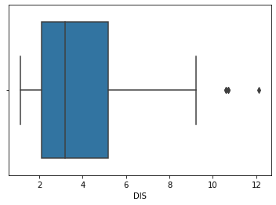
Detect outlier
Box plot for the dataset
print(np.where(df_boston['DIS']>10))
Get all outlier values

Slide 28
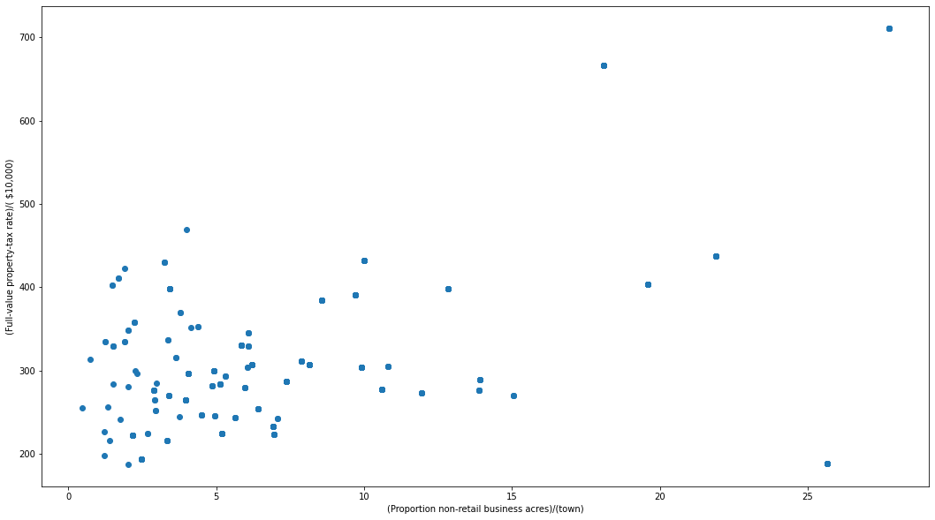
Detect outliers - ScatterPlot.
Outliers

Slide 29
Detect outlier - Z-score
Z- Score is also called a standard score. This value/score helps to understand that how far is the data point from the mean. And after setting up a threshold value one can utilize z score values of data points to define the outliers
Zscore = (data_point -mean) / std. deviation
Define the threshold
For this dataset, 3 is the threshold
Remove outliers by drop the rows
Change them to NA
Use drop.na to remove them
# Z score
from scipy import stats
import numpy as np
z = np.abs(stats.zscore(df_boston['DIS']))
print(z)
Notes:
https://www.geeksforgeeks.org/detect-and-remove-the-outliers-using-python/

Slide 30
Sampling
Sampling in machine learning refers to the process of selecting a subset of data points from a larger dataset. It’s a common technique used for various purposes, such as model training, validation, and testing. Here are some common types of sampling:
Random Sampling: Data points are randomly selected from the dataset without any specific criteria. This is often used for creating training and testing sets.
Stratified Sampling: In this method, the dataset is divided into subgroups or strata, and samples are drawn proportionally from each stratum. This is useful when you want to ensure representation from different classes or categories.
Oversampling and Undersampling: These techniques are used to address class imbalance in classification problems. Oversampling involves creating more samples from the minority class, while undersampling reduces the number of samples from the majority class.
Cross-Validation: It involves splitting the dataset into multiple subsets, typically for training and testing a machine learning model. Common techniques include k-fold cross-validation and leave-one-out cross-validation.
Bootstrapping: Bootstrapping is a resampling technique where multiple random samples are generated from the dataset with replacement. It’s often used for estimating the variability of a statistic or model’s performance.

